Slide 1

Application of Motion-Cueing Algorithm on a Cable-Driven parallel robot In collaboration with: Fraunhofer-Institut für Produktionstechnik und Automatisierung IPA Under the supervision of: Prof. Dr. rer. nat. Felix Hüning Chrisitan Michael Lehnertz, M.Sc
Aadithya Ramamurthy (3304090)
09.05.2025

Slide 2
CONTENTS
Introduction
Motivation and Objective
Fundamentals and Literature
Methodology and Implementation
Evaluation and Results
Conclusion and Outlook
Notes:
Chapter 2 covers the fundamental concepts and theories essential for understanding the study.
Chapter 3 presents the current state of the art, offering a comprehensive literature review on existing motion simulators and related research. It also analyses various MCAs, simulator platforms, and implementation techniques.
Chapter 4 details the methodology employed in this study, including the step-by-step implementation of the MCA on IPAnema 3 and its optimization process.
Chapter 5 discusses the evaluation of the MCA, and the results obtained.
Chapter 6 concludes the work by summarizing the key findings and providing an outlook on potential future research.

Slide 3
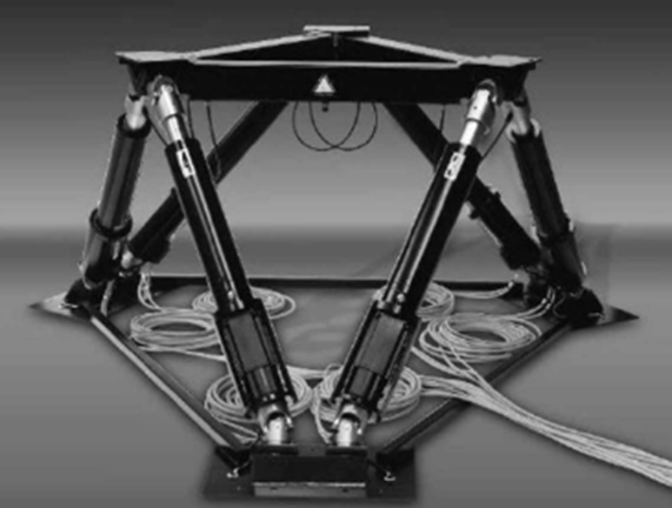
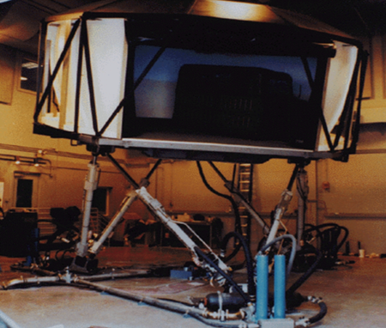
INTRODUCTION
Motion simulators replicate real-world motion.
Mainly used in aviation and automotive industry.
Direct integration → Platform limit violations.
Motion cues → Intertial forces perceived by humans.
Motion Cueing Algorithms (MCAs) simulate these cues.
Hexapods (Stewart-Gough platform) → Traditionally used.
Fig 1: A typical hexapod platform [1]
Fig 2: IOWA driving simulator [2]
Notes:
Motion simulators replicate real-world motion using sensory feedback.
Used in aviation, automotive, VR, robotics for training and research.
Motion cues are the intertial forces induced by translational and rotational acceleration, perceived by humans.
Motion Cueing Algorithms (MCAs) control the platform to simulate these cues.
Direct integration leads to platform limit violations → MCA filters required.
Traditionally, motion simulators have utilized hexapods (Stewart-Gough platform).

Slide 4
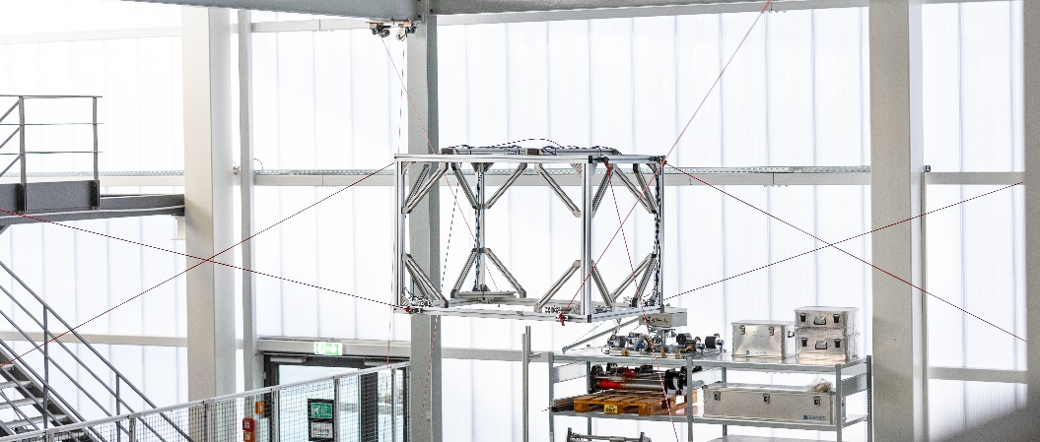
MOTIVATION AND OBJECTIVE
Hexapods → limited motion range.
Cable-Driven Parallel Robots (CDPRs) offer:
Larger motion range
High-speed maneuvering capacity
Long duration manoeuvres
Higher payload-to-weight ratio
Implementing MCA on CDPR IPAnema 3.
Optimising MCA parameters.
Fig 3: IPAnema 3 at Fraunhofer IPA [3]
Notes:
Ideal for large, complex environments requiring versatile motion.
Compared to conventional parallel robots, CDPRs offer a higher and superior dynamic performance.
Hexapods are limited in motion range.
Cable-Driven Parallel Robots (CDPRs) offer:
Larger motion range (Especially translational workspace)
High-speed maneuvering capacity
Long duration manoeuvres involving sustained acceleration.
This work supports Fraunhofer IPA’s vision of developing a CDPR-based motion simulator by implementing MCA on the software simulation of the operational IPAnema 3.
Following the implementation, the MCA parameters are optimized to achieve optimal workspace utilization.

Slide 5
FUNDAMENTALS AND LITERATURE

Slide 6
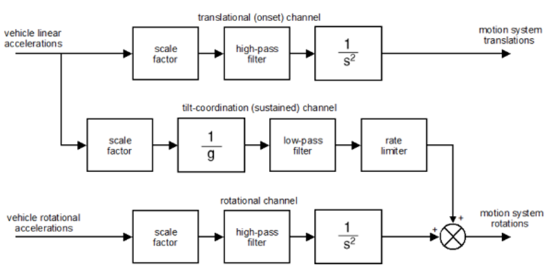
FUNDAMENTALS Classical Washout Algorithm (CWA)
Most widely used MCA.
CWA generates 6-DOF platform commands.
Channels:
Translational
Rotational
Tilt-coordination
Four basic ideas are used in a CWA:
Input Scaling
High-Pass (HP) Filtering
Low-Pass (LP) Filtering
Washout
Fig 4: General Block diagram of CWA [4]
Notes:
Most widely used MCA.
CWA processes simulated motion and generates 6-DOF platform commands.
Input Scaling – Reduces input signal amplitude to fit platform limits.
High-Pass (HP) Filtering – Removes low-frequency(LF) components to prevent excessive drift.
Tilt Coordination – Recreates LF cues by tilting platform using gravity.
Return to Neutral Position (Washout) – Platform smoothly returns to rest when motion ends.

Slide 7
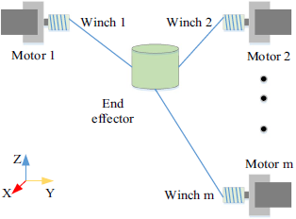
FUNDAMENTALS Cable-Driven Parallel Robots
Main components:
Fixed platform
Mobile platform
Cables
Tensioned cables → Controls suspended mobile platform.
Platform motion → Adjusting cable lengths via winches
Fig 5: Schematic representation of a CDPR[5]
Notes:
A typical CDPR system consists of three main components: a fixed platform, a mobile platform, and multiple cables that connect them.
CDPRs use tensioned cables to control a suspended mobile platform.
Platform motion is achieved by adjusting cable lengths via winches unlike rigid links used in traditional parallel robots.
Ideal for large, complex environments requiring versatile motion.
Compared to conventional parallel robots, CDPRs offer a higher payload-to-weight ratio and superior dynamic performance.

Slide 8
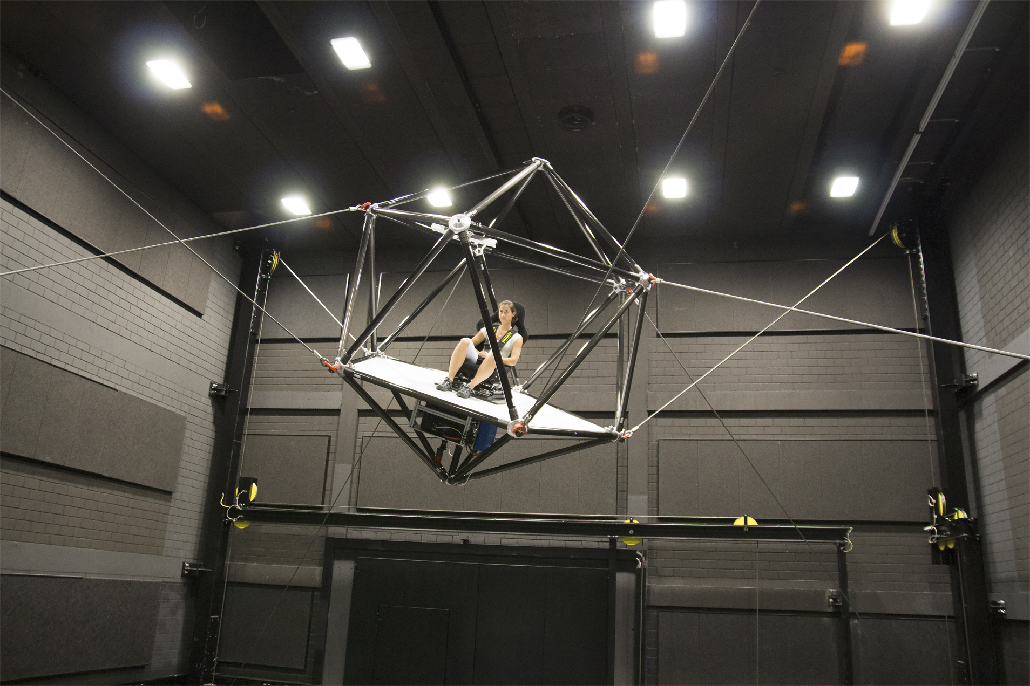
LITERATURE REVIEW Key takeaways
No universally accepted MCA exists.
CWA is widely used.
Platform geometry and workspace constraints → MCAs (relevant to CDPRs).
Parameter optimisation in CWA → Prerecorded simulated trajectory.
Other algorithms → Real-time adaptation
Cable-Robot Simulator (CRS) at Max-Planck Institute (MPI): Only CDPR Simulator
Fig 6: CRS at MPI[6]
Notes:
No universally accepted MCA exists, and each has its own trade-offs. CWA is widely used due to its simplicity and ease of adjustment.
Platform geometry and workspace constraints can be integrated into MCAs which is especially relevant to CDPRs due to cable force distribution.
With CWA, parameter optimisation can be achieved for a prerecorded simulated trajectory.
Other algorithms like adaptive washout or optimal control, emphasize on real-time adaptation.
Cable-Robot Simulator (CRS) at Max-Planck Institute (MPI) is the only existing simulator using a CDPR.

Slide 9
LITERATURE REVIEW Research questions
How…
CWA on a CDPR?
Integration of workspace and geometry constraints of IPAnema 3 with CWA?
Optimisation to tune parameters of CWA?
Different trajectory types and payload affect the CWA parameters?
Notes:
How can the CWA be adapted for use on a CDPR?
How can the workspace and geometry constraints of IPAnema 3 be integrated to ensure force feasibility with the CWA?
How can cost function optimization be used to tune parameters and improve workspace utilization?
How do different trajectory types (aggressive vs. smooth) and payload affect the CWA parameters?

Slide 10
METHODOLOGY AND IMPLEMENTATION

Slide 11
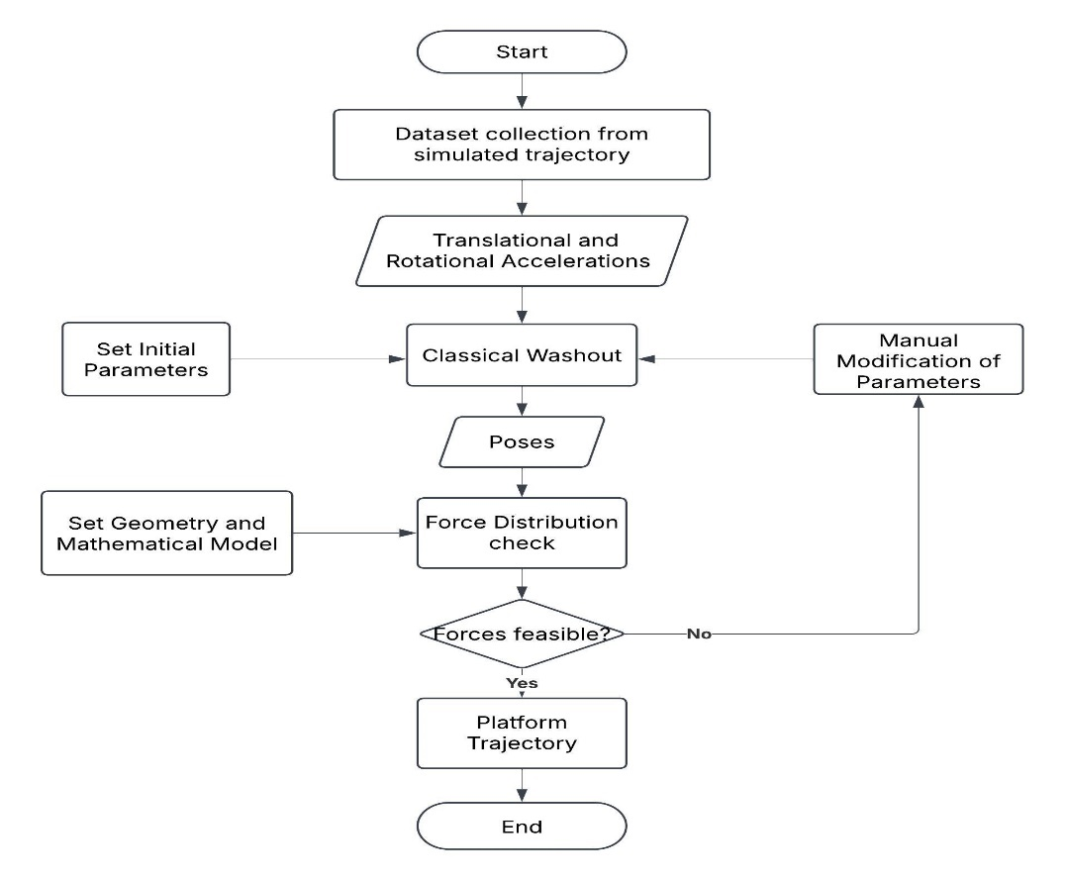
METHODOLOGY AND IMPLEMENTATION Setting up CWA
CWA: First implemented with manually tuned parameters.
Motion data → FlightGear.
CWA processes inputs → Generates 6-DOF pose trajectories.
Force feasibility → Computing cable forces .
Iterative modification of parameters.
Fig 7: Flowchart of manually tuned CWA
Notes:
CWA was first implemented with manually tuned parameters.
Motion data (translational acceleration and rotational rates) collected from FlightGear simulations.
CWA processes inputs to generate 6-DOF pose trajectories.
Force feasibility for IPAnema 3 checked by computing cable forces .
Parameters adjusted iteratively (trial and error) to stay within cable force limits.

Slide 12
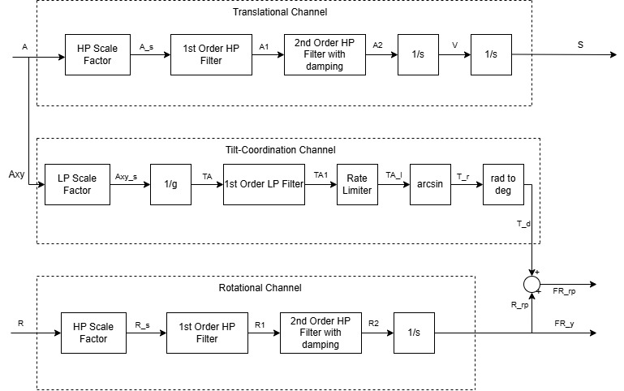
METHODOLOGY AND IMPLEMENTATION Setting up CWA
Implemented in Python.
Input → CSV dataset.
Based on the Reid-Nahon (UTIAS)[7] implementation.
Butterworth filters → Minimal distortion.
Output → Pose commands for the IPAnema 3 platform.
Fig 8: CWA implementation block diagram
Notes:
Implemented in Python using scipy and numpy libraries.
Input: Translational and rotational acceleration data from FlightGear CSV dataset.
Based on the Reid-Nahon (UTIAS)[7] implementation who are the pioneers of CWA.
Butterworth filters were chosen for flat frequency response and minimal distortion. flat frequency response ensures that all frequency components within the passband are processed equally without distortion.
Final output: 6-DOF pose commands for the IPAnema 3 platform.

Slide 13
METHODOLOGY AND IMPLEMENTATION Setting up CWA – Translational Channel
Input: Translational acceleration.
Scaling factor (0–1): Prevents excessive force outputs.
Filtering Stages:
First-order HP filter: Removes sharp and sustained translational accelerations.
Second-order HP filter: Adjustable damping for translational washout.
Double integration → Translational pose.
Figure 9: Translational Channel Implementation block diagram
Notes:
Input: Translational acceleration data from FlightGear.
Optional scaling factor (0–1):
Prevents excessive force outputs.
Adjusted per trajectory based on platform constraints.
Filtering Stages:
First-order HP filter: Removes LF components such as sudden acceleration and slow drift and generates initial motion onset cue.
Second-order HP filter: Includes adjustable damping which controls washout.
Double integration to get the translational pose for IPAnema 3 platform.

Slide 14
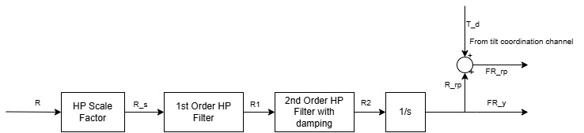
METHODOLOGY AND IMPLEMENTATION Setting up CWA – Rotational Channel
Input: Rotational rate.
Scaling factor (0–1): Reduces rotational intensity.
Filtering Stages:
First-order HP filter: Removes sharp and sustained rotational rates.
Second-order HP filter: Adjustable damping for rotational washout.
Single integration to compute angular displacements → Rotational pose.
Figure 10: Rotational Channel Implementation block diagram
Notes:
Input: Rotational rate data from FlightGear.
Optional scaling factor (0–1): Reduces rotational intensity for trajectories with high angular rates.
Filtering Stages:
First-order HP filter: Removes slow angular drift and sudden changes in rotation rates.
Second-order HP filter: Includes adjustable damping to control rotational washout.
Single integration to compute angular displacements → rotational angles (Roll, Pitch, Yaw).

Slide 15
METHODOLOGY AND IMPLEMENTATION Setting up CWA – Tilt-Coordination channel
Simulates low-frequency (LF) translational accelerations using gravity-induced tilt.
Input: Translational acceleration data (only X and Y axes).
Scaling factor (0–1).
Division by ‘g’.
First-order Low-Pass (LP) filter: Same as HP Cut off from translational channel.
Rate limiter (0.00524 rad/s² or 3°/s)
Arcsine function → Tilt angles (roll/pitch).
Radians to Degrees → Rotational channel.
θ
gSinθ
Figure 11: Tilt-Coordination Channel Implementation block diagram
g
gCosθ
Notes:
Simulates LF translational accelerations using gravity-induced tilt.
Input: Trasnlational acceleration data from FlightGear in X and Y axes.
Scaling factor (0–1): Scales the input based on application needs.
Scaled values divided by g to express acceleration as a gravity ratio. The division by 𝑔g converts the linear acceleration into a gravitational ratio. This ratio represents how much of the platform's tilt would be required to simulate the same inertial force experienced during real acceleration.
First-order Low-Pass (LP) filter: Cut-off matches translational HP filter.
Rate limiter applied to stay within human perception threshold (0.00524 rad/s² converted from 0.3°/s² ).
Arcsine function used to convert scaled values into tilt angles (roll/pitch).
Converted from radians to degrees, then passed to the rotational channel.

Slide 16
METHODOLOGY AND IMPLEMENTATION Force Feasibility with CWA
WiPy: Python wrapper for WireLib
CDPR geometry & kinematics.
Workspace calculation using cable force distribution.
IPAnema 3:
8 cables
6 DOF
Force Limits: 100 N – 3000 N
CWA pose → checked for force feasibility.
Feasible → cable forces returned
Infeasible → marked invalid
Results → CSV
Notes:
WiPy, a Python wrapper for WireLib (developed by Fraunhofer IPA), used for:
CDPR geometry & kinematics
Workspace and Force distribution calculation and force feasibility.
Geometry, kinematics, and cable constraints for IPAnema 3 are configured (8 cables, 6 DOF, 100–3000 N force limits).
Each CWA pose is checked for force feasibility.
Feasible → cable forces returned
Infeasible → marked invalid
Results saved in CSV for further analysis and debugging.
Ensures all motion cues are physically executable on the CDPR before optimization.

Slide 17
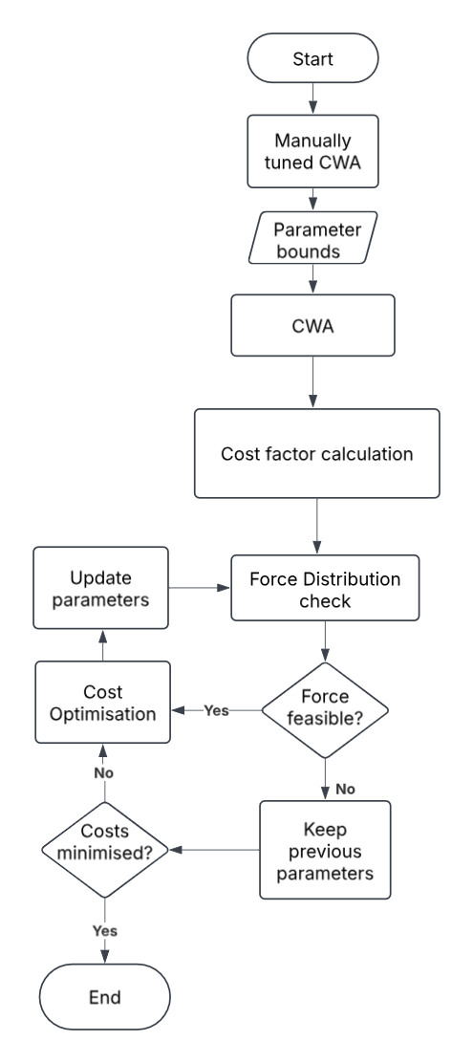
METHODOLOGY AND IMPLEMENTATION Cost function optimisation
Optimisation → Damping factors (Translational)
Cost function → Manually tuned CWA.
Set parameter bounds.
Calculate cost.
Iterative process:
Check force feasibility.
Not feasible → retain previous parameters.
Feasible → proceed to optimisation step.
Cost optimisation
Cost minimised → Stop.
Not minimised → Update parameters and repeat process.
Fig 12: Flowchart of Cost function optimisation
Notes:
Optimisation involves finding the best solution by adjusting controllable variables within given constraints.
Optimization targets damping factors of the CWA as it has a strong influence on washout dynamics
Cost function integrated with manually tuned CWA for improvement.
A cost function quantifies the error between actual and predicted outcomes.
The goal of the cost function optimisation is to minimize the error.
Bounds set using feasible physical limits; initial values from manual tests.
Cost computed based on forces before & after motion cueing.
Iterative process:
Check force feasibility for the resulting pose.
If not feasible, retain previous parameters.
If feasible, proceed to optimization step.
Apply cost optimization to refine parameters.
If cost is minimized, stop. Otherwise, update parameters and repeat process.

Slide 18
METHODOLOGY AND IMPLEMENTATION Defining the Cost function
Force factor(Cost) → Absolute difference between the original and processed forces post CWA, normalized by the original force magnitude.
Normalisation → Relative Absolute Error method by adding a small offset, given by:
The offset is added for two reasons:
Avoiding division by zero.
Mitigating outliers in small forces.
Cost of trajectory → mean of force factor across all datapoints.
Notes:
The force factor, which is the cost function is calculated as the absolute difference between the original and processed forces post CWA, normalized by the original force magnitude.
Normalisation standardises data ranges, making all variables comparable.
Prevents the influence of the inconsistencies when calculating the cost function.
Ensures that no single variable dominates the cost due to scale differences.
The final cost for each trajectory is the mean of force factor across all datapoints from the dataset, providing a measure of how accurately CWA replicates original forces for optimisation.

Slide 19
METHODOLOGY AND IMPLEMENTATION Optimisation of Washout Damping Parameters
Implemented using scipy.optimize.minimize() with L-BFGS-B method.
Force Distribution Validation and Cost Evaluation:
Applies damping → Generates trajectory.
Force feasibility check for each pose.
Returns cost if force feasible, or penalty if invalid.
Minimising the cost:
Set Bounds for parameters.
If minimize() finds a solution → Optimised damping parameters are assigned to the CWA.
If no solution is found → Manually tuned damping parameters are retained.
Notes:
Implemented using scipy.optimize.minimize() with L-BFGS-B method as it is efficient with bounds and memory-light.
Force Distribution Validation and Cost Evaluation:
Applies damping, generates trajectory.
Runs force check for each pose.
Returns cost if feasible, or penalty if invalid.
Minimising the cost:
Bounds set for each damping parameter.
If minimize() finds a solution where it returns a valid cost value, the optimized damping parameter is stored.
If no feasible solution is found, the previous manually tuned damping value is retained.
The optimised damping values are assigned to the CWA.
Ensures cost is minimized and platform remains within force limits.

Slide 20
EVALUATION AND RESULTS

Slide 21
EVALUATION AND RESULTS Evaluation of customised CWA
Trajectory: Normal take-off and landing with limited manoeuvres.
Scaling factors and filter cut-off frequencies → Fixed.
Z-axis force → -1000 N (~102 kg payload).
Manual tuning → Ensured force feasibility.
Notes:
Test case: Normal take-off and landing trajectory with low rotational variation.
Scaling factors and filter cut-off frequencies were kept fixed for consistency and only damping parameters were changed.
Z-axis force set to -1000 N, simulating ~102 kg payload.
Manual tuning of damping parameters ensured all cable forces remained feasible.

Slide 22
EVALUATION AND RESULTS Evaluation of customised CWA
Effect of Cutoff Frequencies in Translational channel:
HP-filtered signals → Short, high-frequency (HF) acceleration bursts.
LP-filtered signals → Sustained and high magnitude change in accelerations.
Effective separation confirms correct filtering.
Notes:
Effect of Cutoff Frequencies on Translational accelerations:
HP-filtered signals short, high-frequency acceleration bursts for translational motion.
LP-filtered signals retain sustained acceelrations and sudden higher magnitude change in accelerations, which are low-frequency trends for tilt coordination.
Effective separation confirms correct filtering for cue distribution across CWA channels.

Slide 23
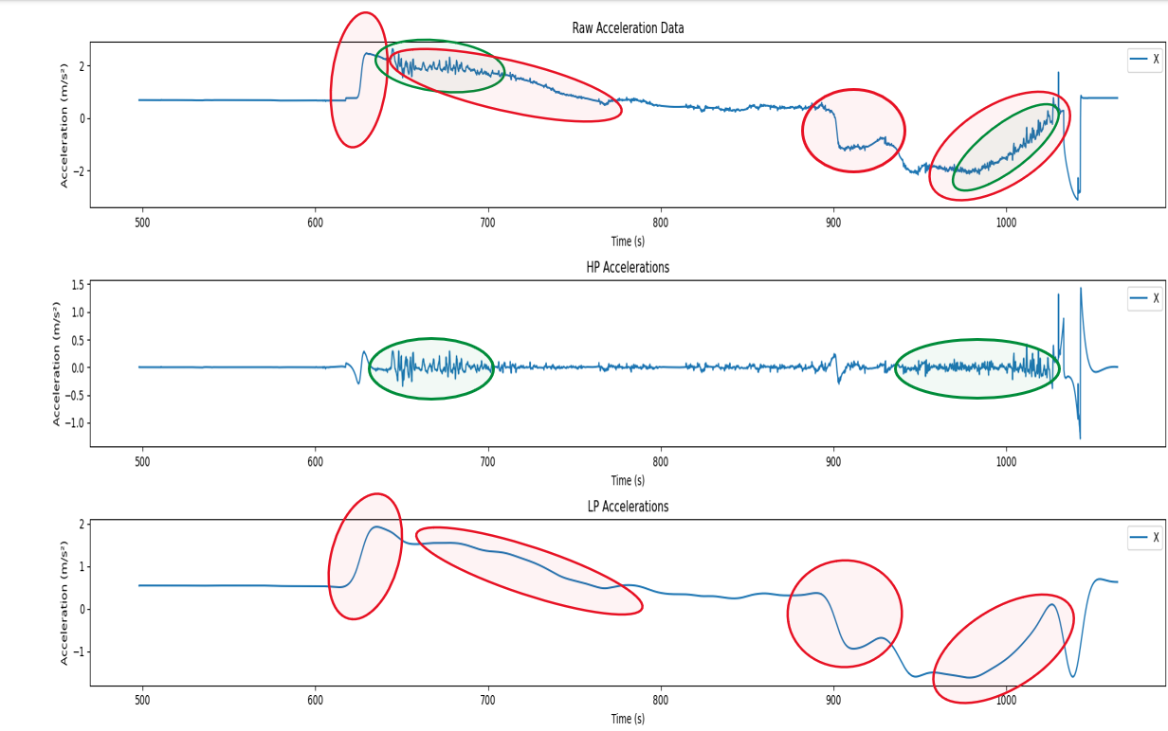
EVALUATION AND RESULTS Evaluation of customised CWA
Effect of Cutoff Frequencies in Translational channel:
Fig 13: Comparison of input accelerations to filtered accelerations X axis translation
Notes:
HP-filtered signals short, high-frequency acceleration bursts for translational motion.
LP-filtered signals retain sustained acceelrations and sudden higher magnitude change in accelerations, which are low-frequency trends for tilt coordination.
Effective separation confirms correct filtering for cue distribution across CWA channels.

Slide 24
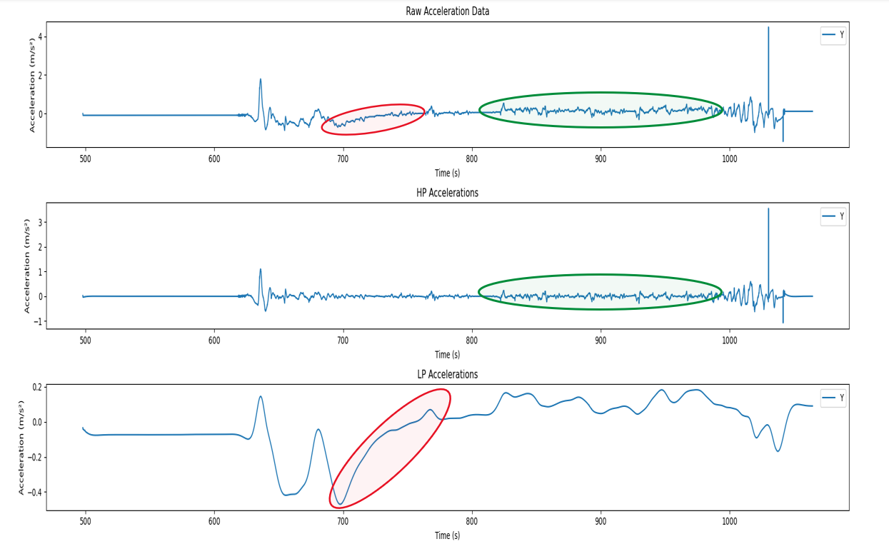
EVALUATION AND RESULTS Evaluation of customised CWA
Effect of Cutoff Frequencies in Translational channel:
Fig 14: Comparison of input accelerations to filtered accelerations Y axis translation

Slide 25
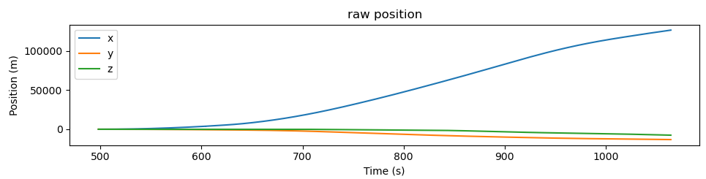
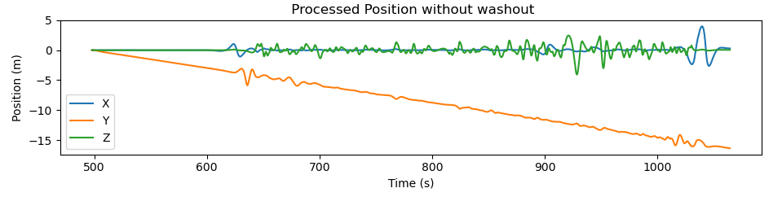
EVALUATION AND RESULTS Evaluation of customised CWA
Effect of Cutoff Frequencies in Translational channel:
Unfiltered integration of raw accelerations → Large position values due LF drift.
HP filtering reduces this drift.
Residual drift emphasizes the need for washout damping.
Figure 15: Positions obtained directly from input accelerations to CWA
Figure 16: Positions obtained from the HP Filtered accelerations without washout damping
Notes:
Effect of Cutoff Frequencies on Translational accelerations:
Unfiltered integration of raw accelerations leads to extremely large position values (>10,000 m in X), due to low-frequency drift.
HP filtering reduces this drift significantly, producing more realistic positions, though some deviation in Y remains (Wind or flight dynamics).
Residual drift emphasizes the need for washout damping to stabilize motion and ensure pose feasibility on IPAnema 3.

Slide 26
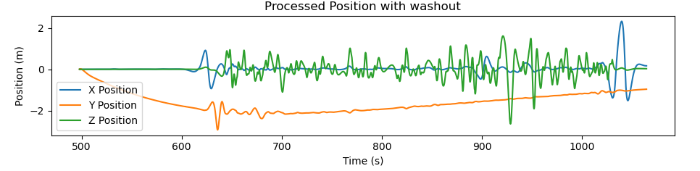
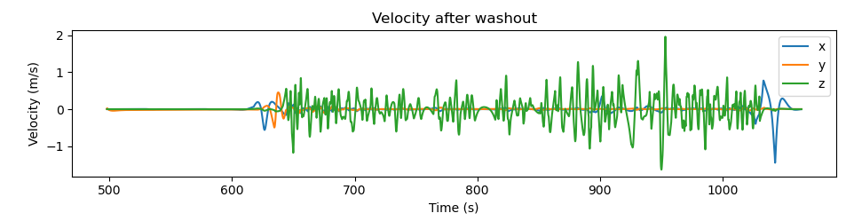
EVALUATION AND RESULTS Evaluation of customised CWA
Effect of Washout Damping Factors in Translation channel
Washout damping → Further reduces drift.
Final position plots → Controlled pose decay confirming effective damping behavior.
Velocity plot → Below 10 m/s limit of IPAnema 3.
Figure 17: Final translational poses of the IPAnema 3 platform
Figure 18: Final velocities of the IPAnema 3 platform
Notes:
Effect of Washout Damping Factors in Translation Channel
Washout damping (via exponential decay) reduces drift and returns the platform to a neutral position, especially in Y-axis.
The final position plots show controlled pose decay in X, Y, and Z, confirming effective damping behavior.
Velocity plot confirms platform speeds stay well below 10 m/s limit, ensuring motion remains within operational constraints of IPAnema 3.

Slide 27
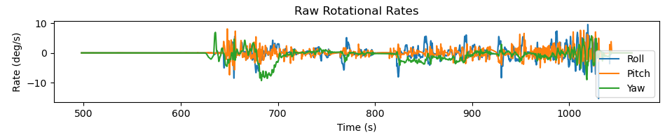
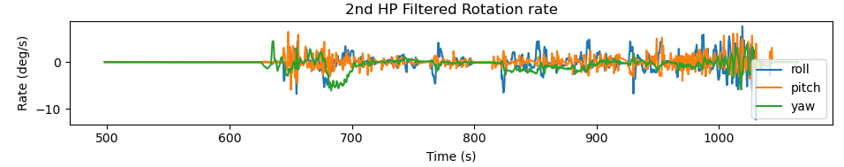
EVALUATION AND RESULTS Evaluation of customised CWA
Effect of Cutoff Frequencies in Rotational channel:
Trajectory had minimal rotational dynamics low → HP cut-off.
Plots show scaled reductions.
No significant change in rotational cue content.
Figure 19:Input Rotational Rates to the CWA
Figure 20: Rotational Rates after HP Filtering
Notes:
Effect of Cutoff Frequencies in Rotational channel:
Trajectory had minimal rotational dynamics, making it suitable for low HP cut-off settings.
Increasing HP cut-off frequency had negligible effect due to lack of high-frequency rotational input.
Plots show mostly scaled reductions, with no significant change in rotational cue content.

Slide 28
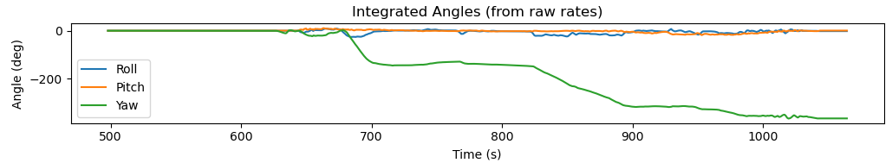
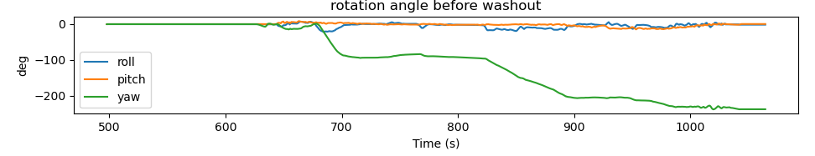
EVALUATION AND RESULTS Evaluation of customised CWA
Effect of Cutoff Frequencies in Rotational channel:
Trajectory included a 360° yaw → yaw scaling > roll/pitch.
Yaw remained high after HP filtering → need for washout.
Figure 21: Rotational angles obtained directly from input rotational rates
Figure 22: Rotational angles obtained from HP Filtered rotational rates without washout
Notes:
The trajectory included a 360° yaw rotation (take-off and landing on same runway), requiring greater yaw scaling than roll/pitch.
HP-filtered rotational rates were integrated to obtain rotation angles.
Yaw remained notably high, highlighting the need for washout damping to prevent excessive yaw drift and ensure feasibility.

Slide 29
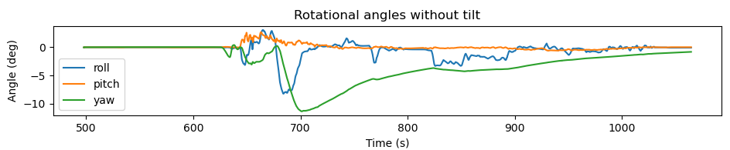
EVALUATION AND RESULTS Evaluation of customised CWA
Effect of Washout Damping Factors in Rotational channel:
Washout damping → Ensured return to neutral position.
Higher yaw damping → Countered large accumulated rotation.
Figure 23: Washout rotational angles without tilt
Notes:
Exponential damping applied to HP-filtered rotational rates to ensure smooth decay to neutral position.
Higher yaw damping used to counter large accumulated rotation.
Post-damping results show reduced yaw and stable roll/pitch angles, validating damping effectiveness before tilt is added.

Slide 30
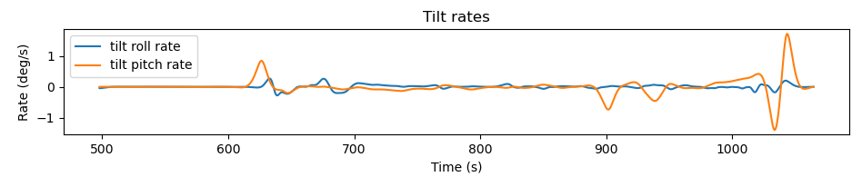
EVALUATION AND RESULTS Evaluation of customised CWA
Summing Tilt Angles in Rotational Channel
Tilt rate < 2°/s → rate limiter not needed.
Tilt angles summed with rotational angles (Roll and Pitch).
Figure 24: Tilt rates obtained from the tilt coordination channel
Notes:
Tilt angles (roll from Y-acceleration, pitch from X-acceleration) are added to rotational angles for final platform orientation.
Tilt rate remains below 2°/s, under the 3°/s perceptual threshold → rate limiter not needed.
Combined plot shows clear influence of tilt on platform orientation, confirming the effectiveness of tilt coordination in the CWA.

Slide 31
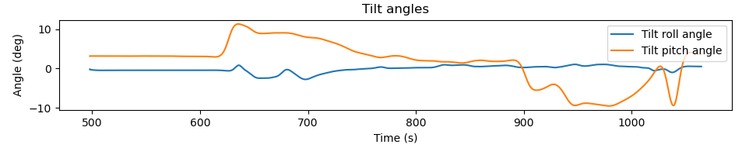
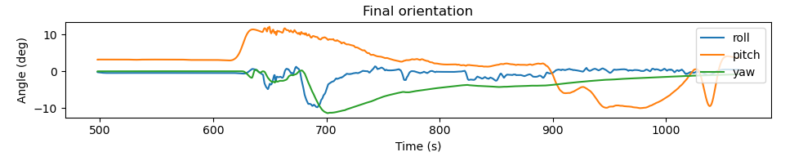
EVALUATION AND RESULTS Evaluation of customised CWA
Summing Tilt Angles in Rotational Channel
Combined plot shows influence of tilt on the final platform orientation.
Figure 25: Tilt angles obtained from the tilt coordination channel
Figure 26: The final orientation of the IPAnema 3 platform
Notes:
Combined plot shows clear influence of tilt on platform orientation, confirming the effectiveness of tilt coordination in the CWA.

Slide 32
EVALUATION AND RESULTS Evaluation of Cost Function Optimisation
Force Factors as Cost Metric
Objective: Match platform (output) forces with simulated (input) forces.
Clear deviations during dynamic events (like landing).
Deviations caused by filtering, damping, and scaling.
Overall force trends are preserved.
Notes:
Force Factors as Cost Metric
Objective: Match platform (output) forces with simulated (input) forces.
Comparison plots show clear deviations during dynamic events (like landing).
Deviations caused by filtering, damping, and scaling in the washout process.
Despite mismatch in magnitude, overall force trends are preserved, confirming motion dynamics are captured.

Slide 33
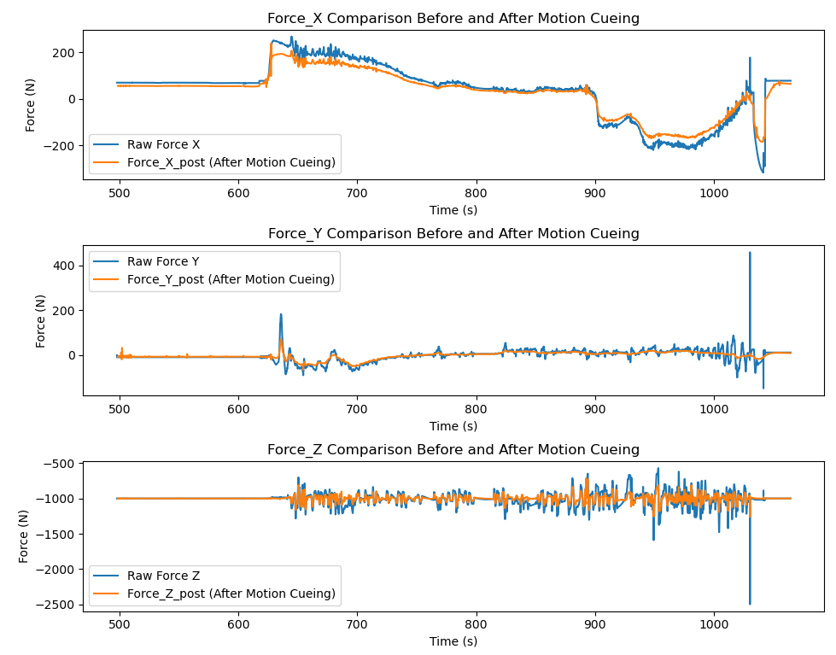
EVALUATION AND RESULTS Evaluation of Cost Function Optimisation
Force Factors as Cost Metric
Figure 27: Comparison of input forces to the forces acting on the platform
Notes:
Force Factors as Cost Metric
Objective: Match platform (output) forces with simulated (input) forces.
Comparison plots show clear deviations during dynamic events (like landing).
Deviations caused by filtering, damping, and scaling in the washout process.
Despite mismatch in magnitude, overall force trends are preserved, confirming motion dynamics are captured.

Slide 34
EVALUATION AND RESULTS Evaluation of Cost Function Optimisation
Outlier Mitigation through Normalisation
RAE-based Force Factor showed extreme outliers.
Outliers distorted the mean cost.
5 N offset → More stable cost function.
Notes:
Initial RAE-based Force Factor showed extreme outliers, especially in Y-axis.
Outliers distorted the mean cost, reducing optimisation effectiveness.
Introduced a 5 N offset in the denominator to suppress spikes which resulted in a more stable cost function for consistent optimisation.
Higher Y-axis variance due to stronger damping, while Z-axis values stayed low due to gravity dominance

Slide 35
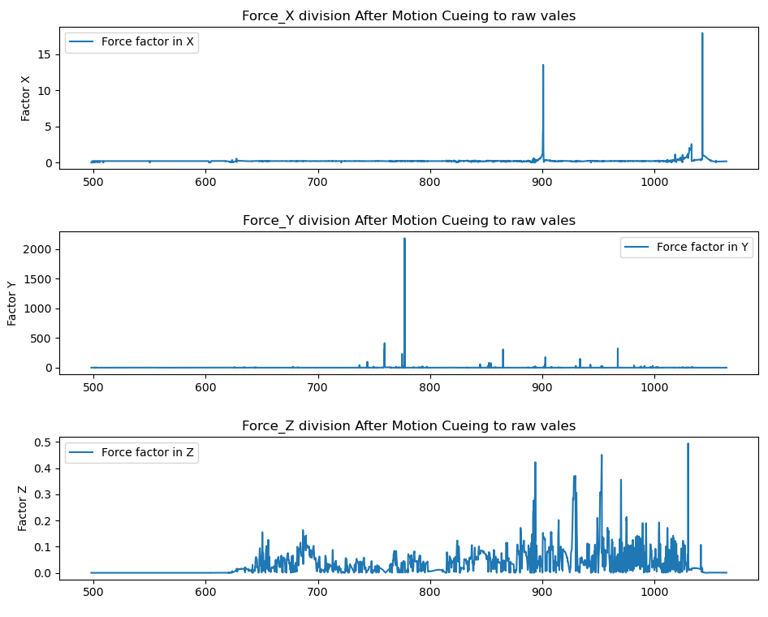
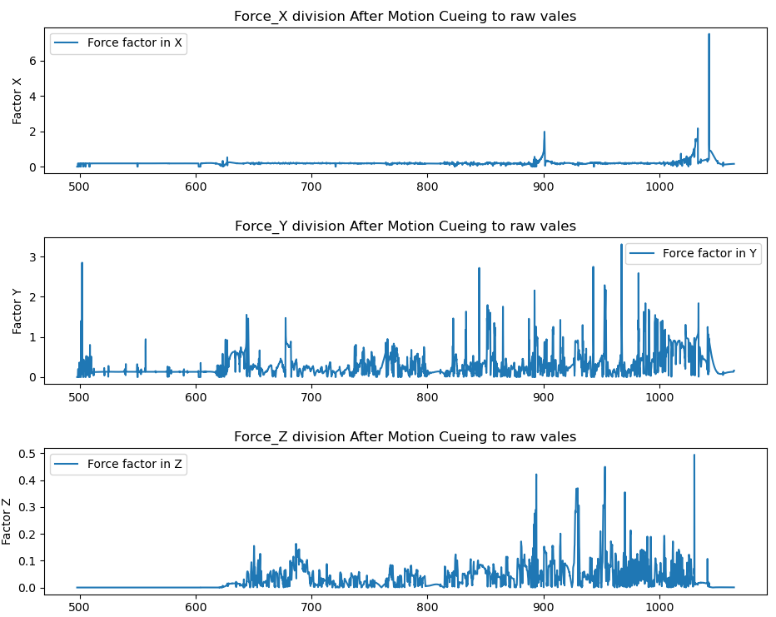
EVALUATION AND RESULTS Evaluation of Cost Function Optimisation
Outlier Mitigation through Normalisation
Figure 28: Force Factors without Offset
Figure 29: Force Factors with Offset
Notes:
Initial RAE-based Force Factor showed extreme outliers, especially in Y-axis.
Outliers distorted the mean cost, reducing optimisation effectiveness.
Introduced a 5 N offset in the denominator to suppress spikes which resulted in a more stable cost function for consistent optimisation.
Higher Y-axis variance due to stronger damping, while Z-axis values stayed low due to gravity dominance

Slide 36
EVALUATION AND RESULTS Evaluation of Cost Function Optimisation
Cost Function Optimisation Results
Table 1: Force factors and washout damping factors
Axis | Average force factors/cost (manual tuning) | Average force factors/cost (post optimisation) | Manual washout damping factors (translational)
X | 0.2101 | 0.2271 | 0.001
Y | 0.3002 | 0.2971 | 0.005
Z | 0.0345 | 0.0505 | 0.001
Optimised washout damping factors (translational)
0.00470148
0.00470148
0.00470153
Multi-Axis optimisation trade-offs.
Effect of strong manual tuning.
Notes:
The obtained average force factors with manual tuning, average force factors after the optimisation and washout damping factor after optimisation are mentioned in Table 1.
Multi-Axis Optimization Trade-Offs:
Y-axis force factor improved, but X and Z errors slightly increased.
This outcome illustrates a typical case of multi-objective optimisation trade-offs.
Caused by coupled dynamics of the CDPR — motion in one axis affects cable tensions system-wide.
Optimization prioritized Y-axis, where initial error was highest and improvement most impactful.
Effect of Strong Manual Tuning:
Pre-optimization settings were already well-refined through iterative force validation.
Hence, numerical gains from optimization were moderate.

Slide 37
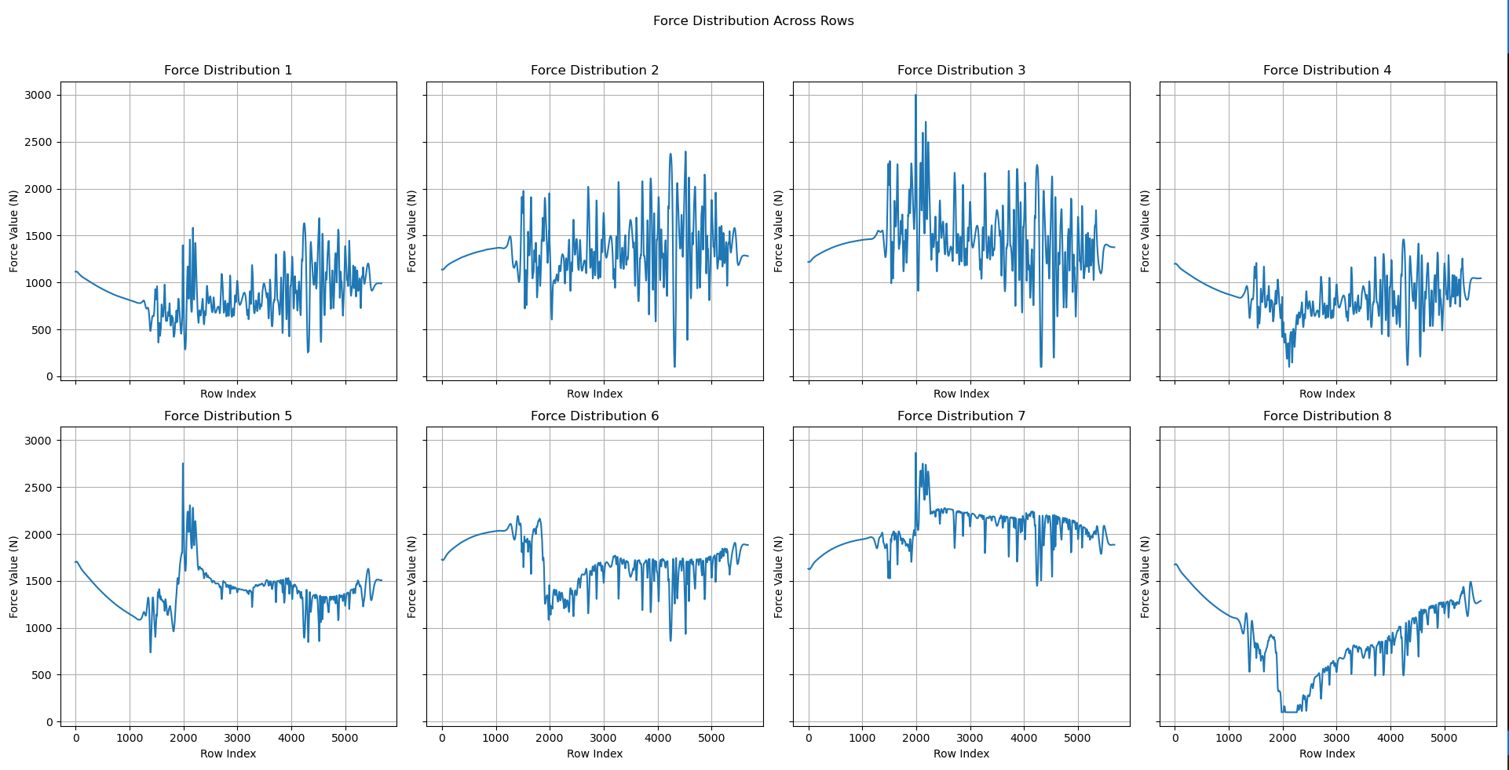
EVALUATION AND RESULTS Evaluation of Cost Function Optimisation
Cost Function Optimisation Results
Improved Force Stability
Figure 30: Force distribution on cables before optimisation
Notes:
Post-optimization plots show fewer force spikes, smoother transitions.
Indicates lower mechanical stress on the CDPR and its mechanical parts.
Despite modest improvements in numerical force factor values, overall force stability improved noticeably.

Slide 38
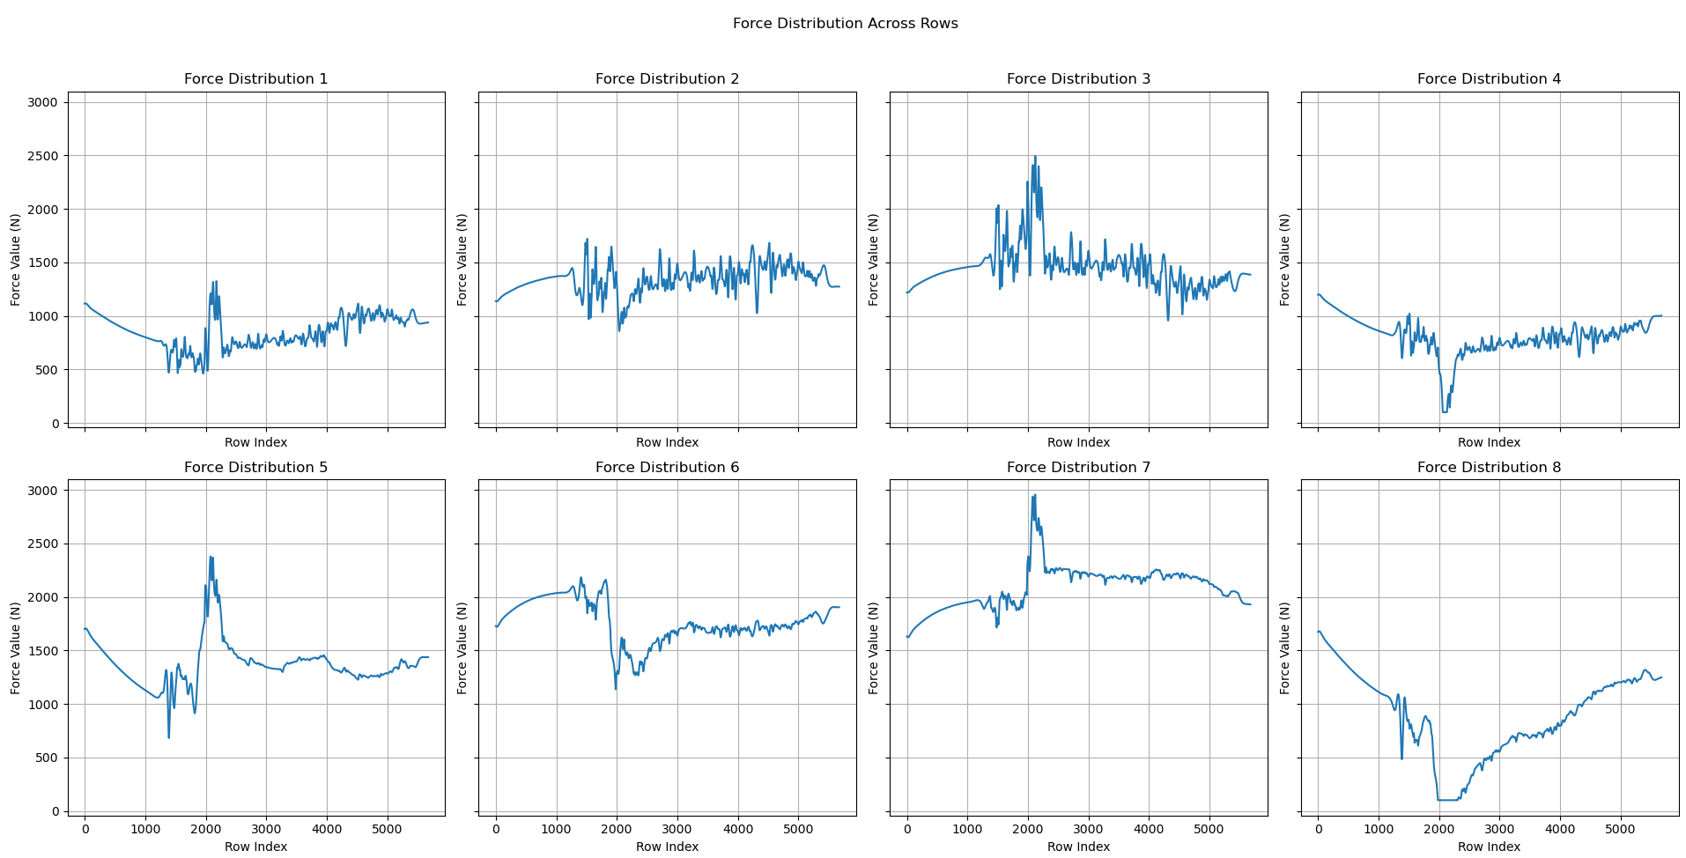
EVALUATION AND RESULTS Evaluation of Cost Function Optimisation
Cost Function Optimisation Results
Improved Force Stability
Figure 31: Force distribution on cables after optimisation
Notes:
Post-optimization plots show fewer force spikes, smoother transitions.
Indicates lower mechanical stress on the CDPR and its mechanical parts.
Despite modest improvements in numerical force factor values, overall force stability improved noticeably.

Slide 39
EVALUATION AND RESULTS Evaluation on Dynamic Trajectory
Table 2: Force factors and washout damping factors for dynamic trajecory
Axis | Average force factors/cost (manual tuning) | Average force factors/cost (post optimisation) | Manual washout damping factors (translational)
X | 0.2176 | 0.2351 | 0.001
Y | 0.5563 | 0.5527 | 0.005
Z | 0.2850 | 0.2826 | 0.005
Optimised washout damping factors (translational)
0.00482051
0.00482051
0.00482056
Higher Z and Yaw manual damping.
Higher force factors in Y and Z axes.
Notes:
Test case: more aggressive flight path with sharp turns, climbs, and high rotational rates.
Scaling factors and cut-off frequencies kept consistent with the first test.
The final parameter values for this trajectory are given in Table 4
Z and yaw damping increased to manage larger excursions from neutral position.
Higher force factors in Y and Z axes due to:
Dynamic manoeuvres → challenging to replicate lateral forces with limited motion range.
Vertical climbs/drops → introduce large force shifts, especially during washout to neutral.
Despite higher errors, system maintained force feasibility across trajectory

Slide 40
EVALUATION AND RESULTS Evaluation on High Payload
Z-axis force → -2400 N (~245 kg payload - IPAnema 3’s max capacity)
Table 3: Force factors and washout damping factors for high payload
Axis | Average force factors/cost (manual tuning) | Average force factors/cost (post optimisation) | Manual washout damping factors (translational)
X | 0.2300 | 0.2361 | 0.002
Y | 0.4010 | 0.3514 | 0.006
Z | 0.0410 | 0.0459 | 0.002
Optimised washout damping factors (translational)
0.00307043
0.00307043
0.00307049
Higher initial manual damping.
Reduced effective workspace.
Notes:
Reused the original smooth trajectory, now tested with a high payload
Applied Z-axis force of -2400 N (~245 kg payload weight), approaching IPAnema 3’s max capacity of 250 kg.
Final optimized parameters for this case are listed in Table 5.
Evaluation aimed to assess CWA robustness under near-limit loading while ensuring force feasibility.
Observation
Higher initial damping (manual) used for translational and rotational channels to ensure force feasibility under heavy load.
Conservative damping and high payload led to a reduced effective workspace.
Y-axis force factor improved significantly after optimization which implies that the manual Y-damping was suboptimal.
X and Z damping increased slightly post-optimization to compensate force coupling, mirroring trade-offs seen in lower payload tests.

Slide 41
EVALUATION AND RESULTS Comparision
Table 4: Comparison of final parameters
Trajectory type | Manual damping [X, Y, Z] | Optimised damping [X, Y, Z] | Manual damping [roll, pitch, yaw] | Manual average force factor [X, Y, Z] | Optimised average force factor [X, Y, Z]
Trajectory 1 with Z = -1000N | [0.001, 0.005, 0.001] | [0.00470148, 0.00470148, 0.00470153] | [0.005, 0.007, 0.01] | [0.2101, 0.3002, 0.0345] | [0.2271, 0.2971, 0.0505]
Trajectory 2 with Z = -1000N | [0.001, 0.005, 0.005] | [0.00482051, 0.00482051, 0.00482056] | [0.005, 0.007, 0.018] | [0.2176, 0.5563, 0.2850] | [0.2351, 0.5527, 0.2826]
Trajectory 1 With Z = -2400N | [0.002, 0.006, 0.002] | [0.00307043, 0.00307043, 0.00307049] | [0.006, 0.008, 0.02] | [0.2300, 0.4010, 0.0410] | [0.2361, 0.3514, 0.0459]

Slide 42
CONCLUSION AND OUTLOOK

Slide 43
CONCLUSION AND OUTLOOK Summary
Demonstrated a systematic, force feasible approach for motion cueing using CWA for the CDPR IPAnema 3 platform.
Introduced a cost function optimization to this CWA.
Results → Modest improvements in cost but improved force stability.
Notes:
Developed and evaluated a CWA for the CDPR IPAnema 3.
Literature review identified a gap in applying washout algorithms to CDPRs.
Implemented cascaded filtering, scaling, and manual tuning of damping parameters, followed by force feasibility validation.
Introduced a cost function (modified RAE with offset) to quantify force deviation and guide optimisation.
Applied L-BFGS-B optimisation to refine translational damping, constrained by force feasibility.
Results showed smoother cable force distribution and improved force stability, even under dynamic and high-payload scenarios.
Demonstrated a systematic, force-feasible tuning approach for motion cueing in CDPR-based simulation platforms.

Slide 44
CONCLUSION AND OUTLOOK Future work
Hardware Implementation.
Optimisation of rotational parameters.
Axis-Wise independent optimization.
Adaptive platform orientation and origin shifting.
Real time optimisation.
Generalisation to other CDPR systems.
Notes:
Real-World implementation on the hardware.
Extending optimisation to rotational parameters, incorporating checks for cable collisions.
Axis-Wise independent optimization.
Adaptive platform orientation and origin shifting.
Online optimisation and real-time cueing.
Integration of pilot feedback and visual cues.
Generalisation to other CDPR systems.

Slide 45
REFERENCES
[1] Casas, S., Olanda, R., & Dey, N. (2017). “Motion cueing algorithms: A review. Algorithms, evaluation and tuning”. International Journal of Virtual and Augmented Reality, 1(1), 90–106. DOI: 10.4018/IJVAR.2017010107​
[2] Kuhl, J. G., Evans, D., Papelis, Y., Romano, R., & Watson, G. (1995). “The Iowa Driving Simulator: An Immersive Research Environment”. IEEE Computer, 28(7), 35–41. DOI: 10.1109/2.391039
[3] Fraunhofer IPA, Cable-Driven Parallel Robots. [Online]. Available: https://www.ipa.fraunhofer.de/en/expertise/robot-and-assistive-systems/intralogistics-and-material-flow/cable-driven-parallel-robot.html
[4] A. H. J. Jamson, "Motion Cueing in Driving Simulators for Research Applications", Ph.D. dissertation, Univ. of Leeds, 2010. [Online]. Available: https://core.ac.uk/download/pdf/1145908.pdf
[5] Qian, S., Zi, B., Shang, W.-W., & Xu, Q.-S. (2018). “A Review on Cable-driven Parallel Robots”. Chinese Journal of Mechanical Engineering, 31, Article 66. DOI: 10.1186/s10033-018-0267-9
[6] P. Miermeister, M. Lächele, R. Boss, C. Masone, M. F. Huber, A. Schlaefer, A. Pott, and H. H. Bülthoff, "The CableRobot Simulator: Large Scale Motion Platform Based on Cable Robot Technology," in 2016 IEEE/RSJ International Conference on Intelligent Robots and Systems (IROS), Daejeon, South Korea, 2016, pp. 3024–3029. DOI: 10.1109/IROS.2016.7759468.
[7] Reid, L. D., & Nahon, M. A. (1985). Flight Simulation Motion-Base Drive Algorithms: Part 1 - Developing and Testing the Equations. University of Toronto. [Online]. Available: https://repository.tudelft.nl/record/uuid:45b071c0-0568-4e8f-948f-dfa52d350665

Slide 46
THANK YOU ☺
Open for questions

